Slide 1
Clustering 聚类
Lectured by Shangsong Liang 梁上松
School of Computer Science, 计算机学院
Sun Yat-sen University
Notes:
Some slides were from Tan, Steinbach, Karpatne, Kumar

Slide 2
Outline
Prototype-based
  Fuzzy c-means
  Mixture Model Clustering
  Self-Organizing Maps
Density-based
  Grid-based clustering
  Subspace clustering
Graph-based
  Chameleon
  Jarvis-Patrick
  Shared Nearest Neighbor (SNN)
Characteristics of Clustering Algorithms

Slide 3
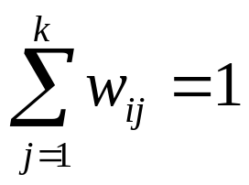
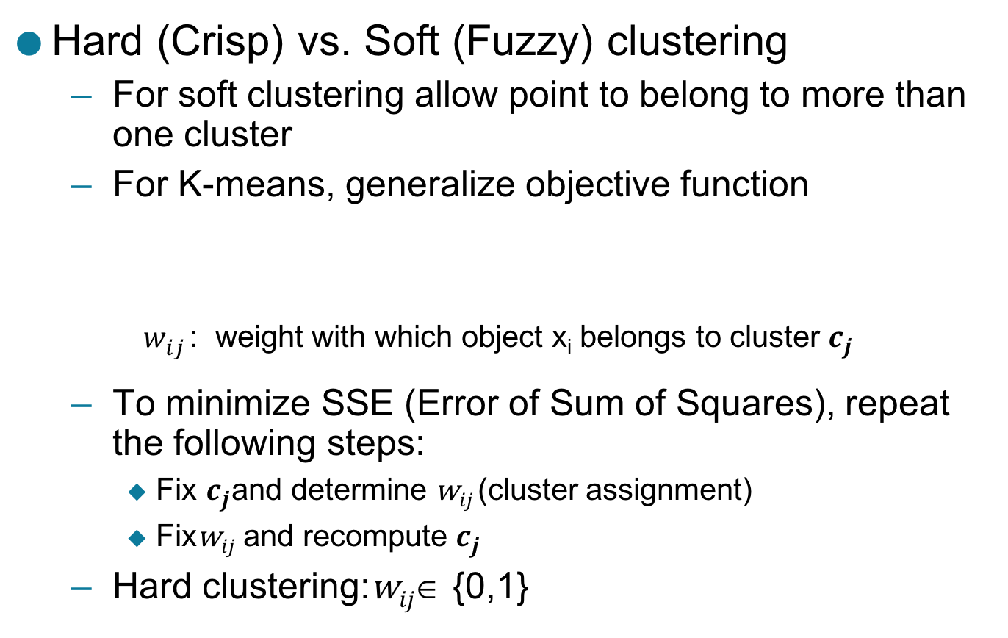
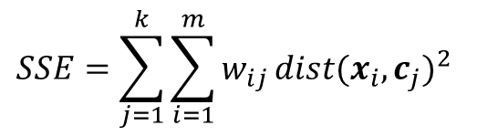
Hard (Crisp) vs Soft (Fuzzy) Clustering
Hard (Crisp) vs. Soft (Fuzzy) clustering
  For soft clustering allow point to belong to more than one cluster
  For K-means, generalize objective function
    $w_{ij}^{}$: weight with which object x_{i} belongs to cluster $c_{j}$
  To minimize SSE (Error of Sum of Squares), repeat the following steps:
    Fix $c_{j}$and determine w$ij$(cluster assignment)
    Fixw$ij$ and recompute $c_{j}$
  Hard clustering:w$ij$∈ {0,1}
$$SSE=\sum_{j=1}^{k}{\sum_{i=1}^{m}{w_{ij}}}{dist(x_{i},c_{j})}^{2}$$

Slide 4
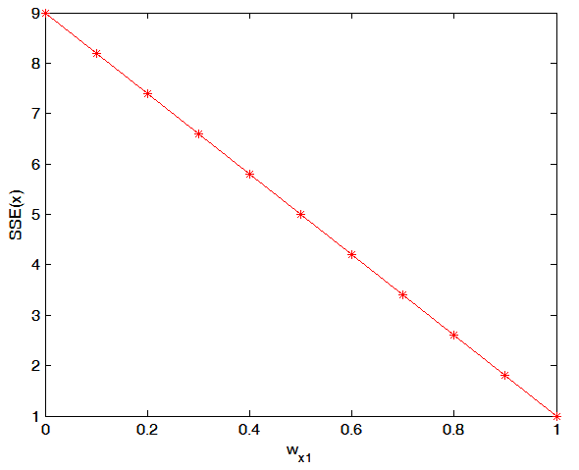
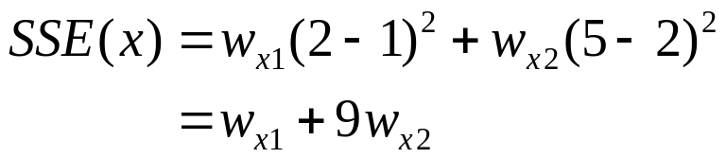
Soft (Fuzzy) Clustering: Estimating Weights
c₁
x
c₂
1
2
5
SSE(x) is minimized when w_{x1} = 1, w_{x2} = 0

Slide 5

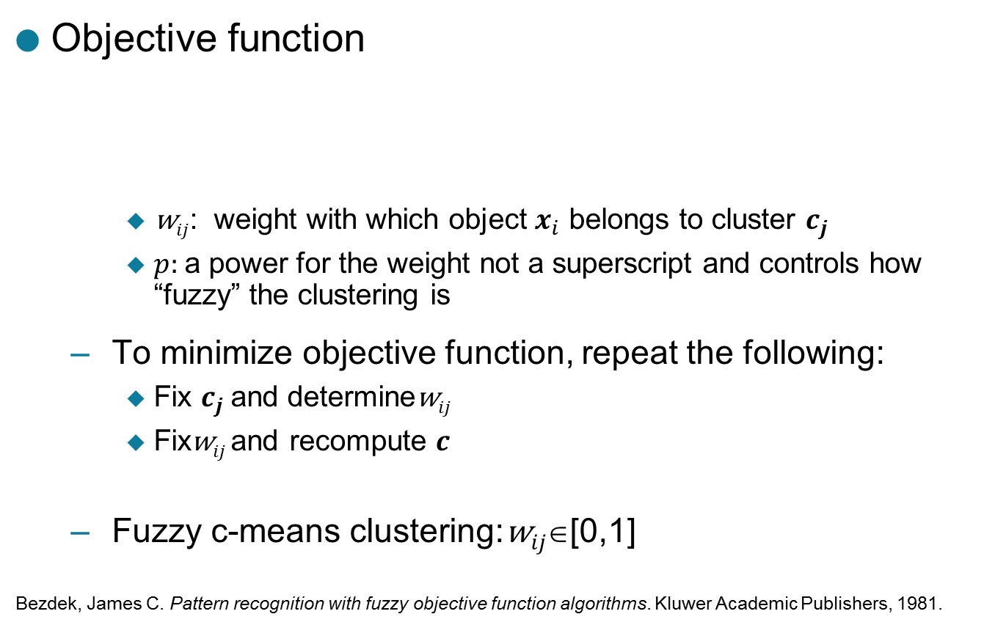
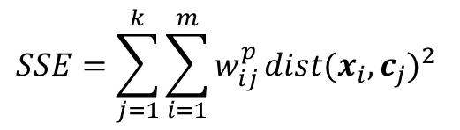
Fuzzy C-means
p: fuzzifier (p > 1)
Objective function
    $\text{w}ij$: weight with which object $x_{i}$ belongs to cluster $c_{j}$
    $p:$a power for the weight not a superscript and controls how “fuzzy” the clustering is
  To minimize objective function, repeat the following:
    Fix $c_{j}$and determinew$ij$
    Fixw$ij$and recompute $c$
  Fuzzy c-means clustering:w$ij$∈[0,1]
  Bezdek, James C. Pattern recognition with fuzzy objective function algorithms. Kluwer Academic Publishers, 1981.
$$SSE=\sum_{j=1}^{k}{\sum_{i=1}^{m}{w_{ij}^{p}}}{dist(x_{i},c_{j})}^{2}$$

Slide 6
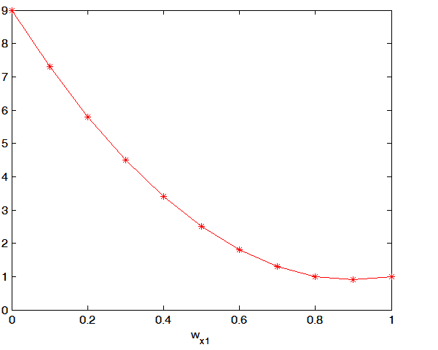
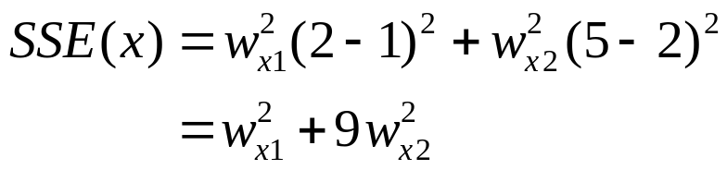
Fuzzy C-means
c₁
x
c₂
1
2
5
SSE(x)
SSE(x) is minimized when w_{x1} = 0.9, w_{x2} = 0.1

Slide 7
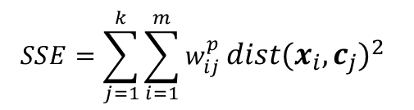
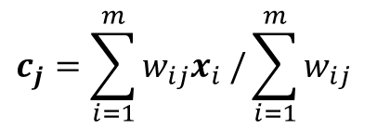
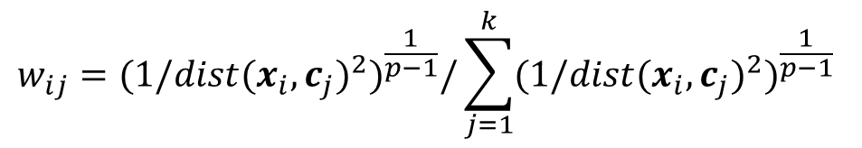
Fuzzy C-means
Objective function:
Initialization: choose the weights w_{ij} randomly
Repeat:
  Update centroids:
  Update weights:
p: fuzzifier (p > 1)
$$SSE=\sum_{j=1}^{k}{\sum_{i=1}^{m}{w_{ij}^{p}}}{dist(x_{i},c_{j})}^{2}$$
$$c_{j}=\sum_{i=1}^{m}{w_{ij}x_{i} /}\sum_{i=1}^{m}{w_{ij}}$$
$$w_{ij}={{(1/dist(x_{i},c_{j})}^{2})}^{\frac{1}{p−1}}/\sum_{j=1}^{k}{{{(1/dist(x_{i},c_{j})}^{2})}^{\frac{1}{p−1}}}$$

Slide 8
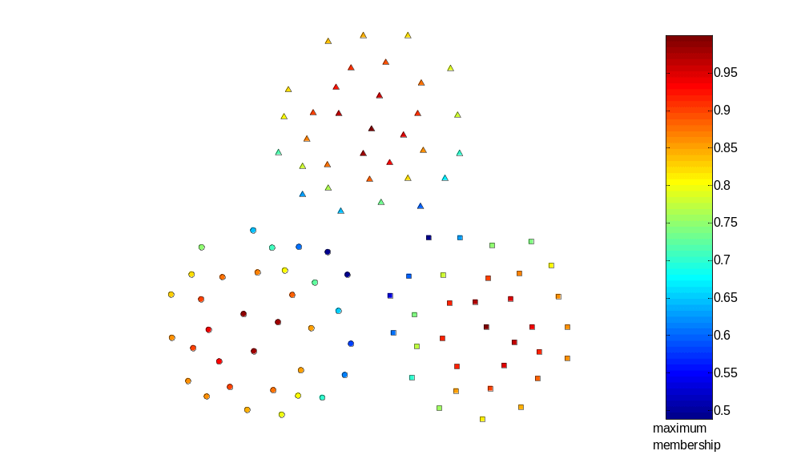
Fuzzy K-means Applied to Sample Data

Slide 9
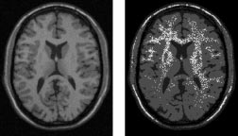
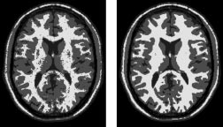
An Example Application: Image Segmentation
Modified versions of fuzzy c-means have been used for image segmentation
  Especially fMRI images (functional magnetic resonance images)
References
  Gong, Maoguo, Yan Liang, Jiao Shi, Wenping Ma, and Jingjing Ma. "Fuzzy c-means clustering with local information and kernel metric for image segmentation." Image Processing, IEEE Transactions on 22, no. 2 (2013): 573-584.
  From left to right: original images, fuzzy c-means, EM, BCFCM
  Ahmed, Mohamed N., Sameh M. Yamany, Nevin Mohamed, Aly A. Farag, and Thomas Moriarty. "A modified fuzzy c-means algorithm for bias field estimation and segmentation of MRI data." Medical Imaging, IEEE Transactions on 21, no. 3 (2002): 193-199.

Slide 10
Hard (Crisp) vs Soft (Probabilistic) Clustering
Idea is to model the set of data points as arising from a mixture of distributions
  Typically, normal (Gaussian) distribution is used
  But other distributions have been very profitably used
Clusters are found by estimating the parameters of the statistical distributions
  Can use a k-means like algorithm, called the Expectation-Maximization (EM) algorithm, to estimate these parameters
    Actually, k-means is a special case of this approach
  Provides a compact representation of clusters
  The probabilities with which point belongs to each cluster provide a functionality similar to fuzzy clustering.

Slide 11
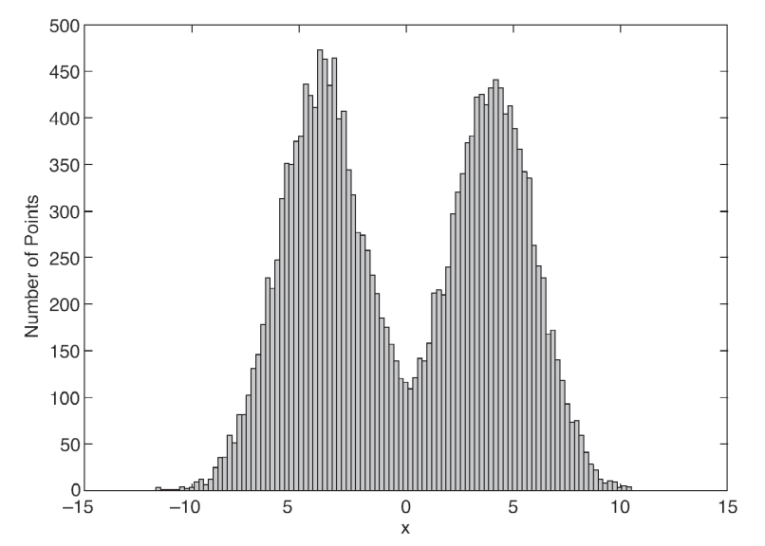
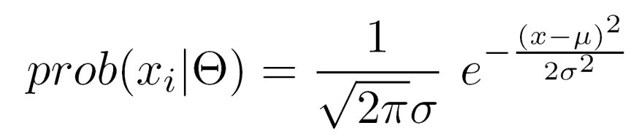
Probabilistic Clustering: Example
Informal example: consider
modeling the points that
generate the following
histogram.
Looks like a combination of two
normal (Gaussian) distributions
Suppose we can estimate the
mean and standard deviation of each normal distribution.
  This completely describes the two clusters
  We can compute the probabilities with which each point belongs to each cluster
  Can assign each point to the
  cluster (distribution) for which it
  is most probable.

Slide 12
Probabilistic Clustering: EM Algorithm
Initialize the parameters
Repeat
  For each point, compute its probability under each distribution
  Using these probabilities, update the parameters of each distribution
Until there is no change
Very similar to K-means
Consists of assignment and update steps
Can use random initialization
  Problem of local minima
For normal distributions, typically use K-means to initialize
If using normal distributions, can find elliptical as well as spherical shapes.

Slide 13
Mixtures of Gaussians
K-means algorithm
  Assigned each example to exactly one cluster
  What if clusters are overlapping?
    Hard to tell which cluster is right
    Maybe we should try to remain uncertain
  Used Euclidean distance
  What if cluster has a non-circular shape?
Gaussian mixture models
  Clusters modeled as Gaussians
    Not just by their mean
  EM algorithm: assign data to
  cluster with some probability

Slide 14
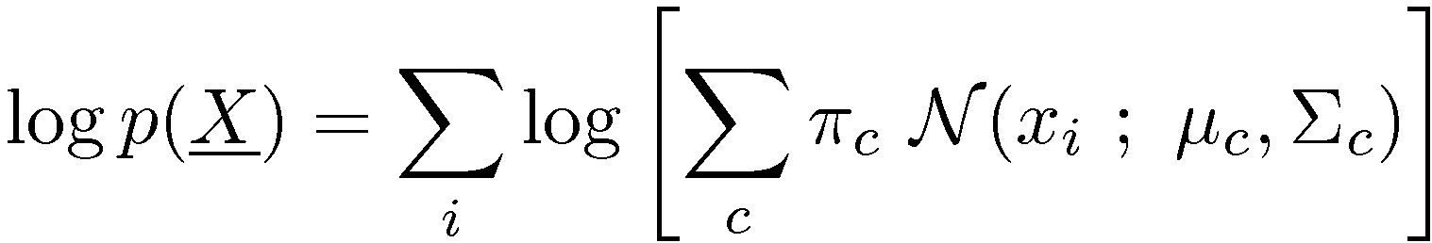
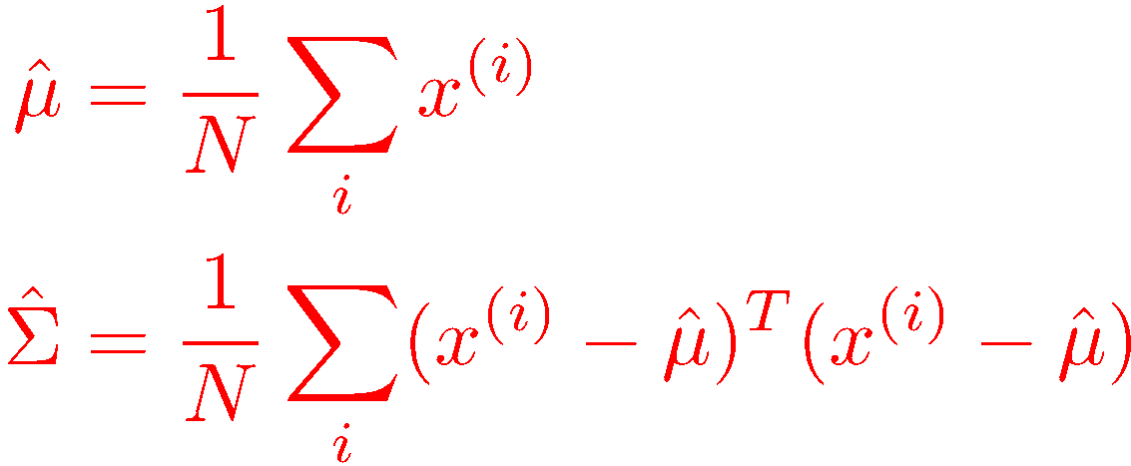
Multivariate Gaussian models
5
Maximum Likelihood estimates
4
3
2
1
0
We’ll model each cluster using one of these Gaussian “bells”…
-1
-2
-2
-1
0
1
2
3
4
5

Slide 15
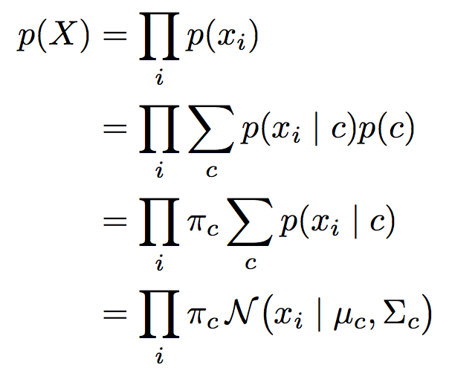
Multivariate Gaussian models
The goal is to maximize the following objective

Slide 16
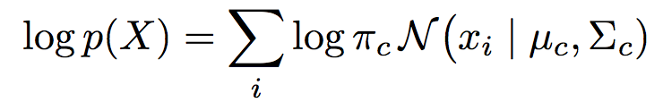
Multivariate Gaussian models
Maximizing the above objective is equal to maximizing the following:

Slide 17
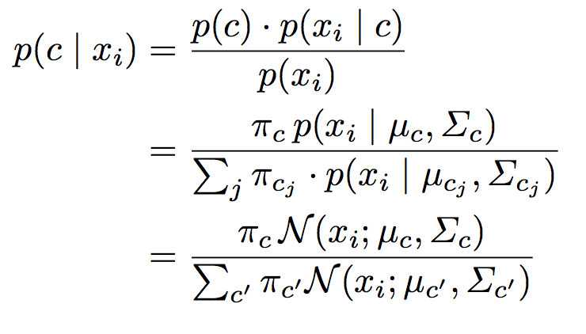
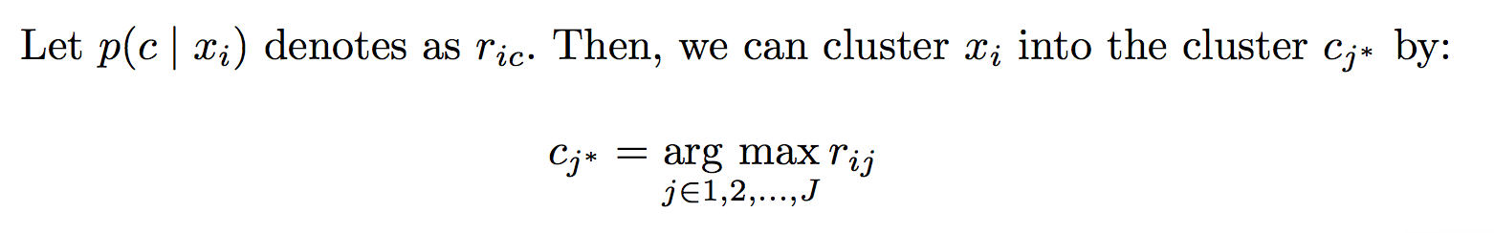
Multivariate Gaussian models
If we have know all the parameters: means, the covariances, and the sizes. We can cluster the data as the following:

Slide 18
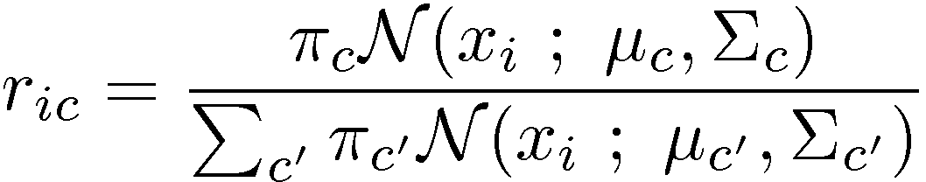
EM Algorithm: E-step
Start with parameters describing each cluster
Mean, Covariance, “size”
E-step (“Expectation”)
  For each datum (example) x_i,
  Compute “r_{ic}”, the probability that it belongs to cluster c
    Compute its probability under model c
    Normalize to sum to one (over clusters c)
  If x_I is very likely under the c^{th} Gaussian, it gets high weight
  Denominator just makes r’s sum to one

Slide 19
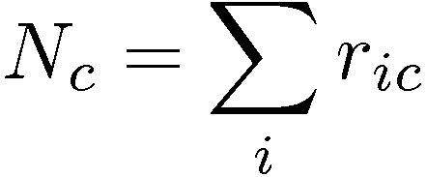
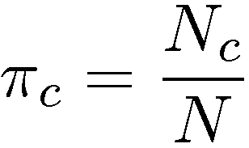
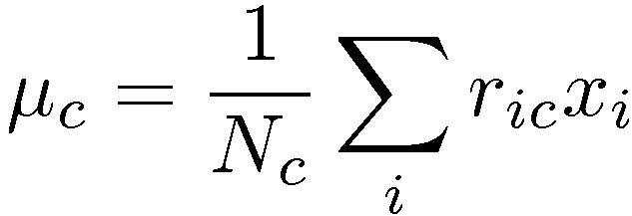
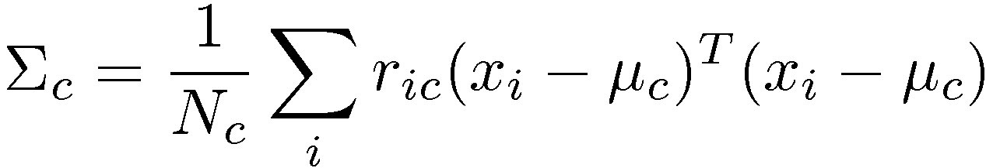
EM Algorithm: M-step
Start with assignment probabilities r_{ic}
Update parameters: means, Covariances, “sizes”
M-step (“Maximization”)
  For each cluster (Gaussian) x_c,
  Update its parameters using the (weighted) data points
Total responsibility allocated to cluster c
Fraction of total assigned to cluster c
Weighted mean of assigned data
Weighted covariance of assigned data
(use new weighted means here)

Slide 20
Expectation-Maximization
Each step increases the log-likelihood of our model
(we won’t derive this, though)
Iterate until convergence
  Convergence guaranteed – another ascent method
What should we do
  If we want to choose a single cluster for an “answer”?
  With new data we didn’t see during training?

Slide 21
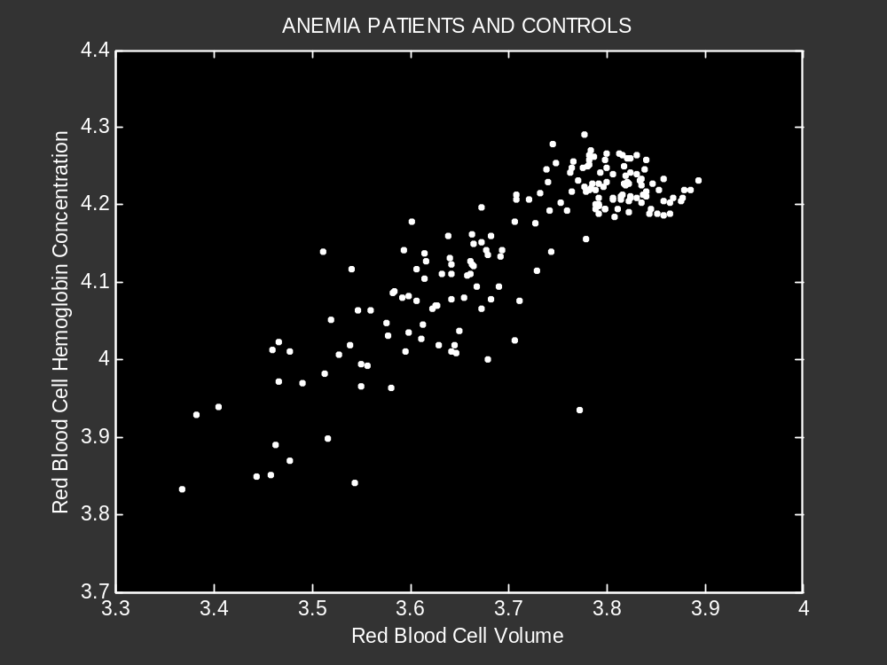
From P. Smyth
ICML 2001

Slide 22
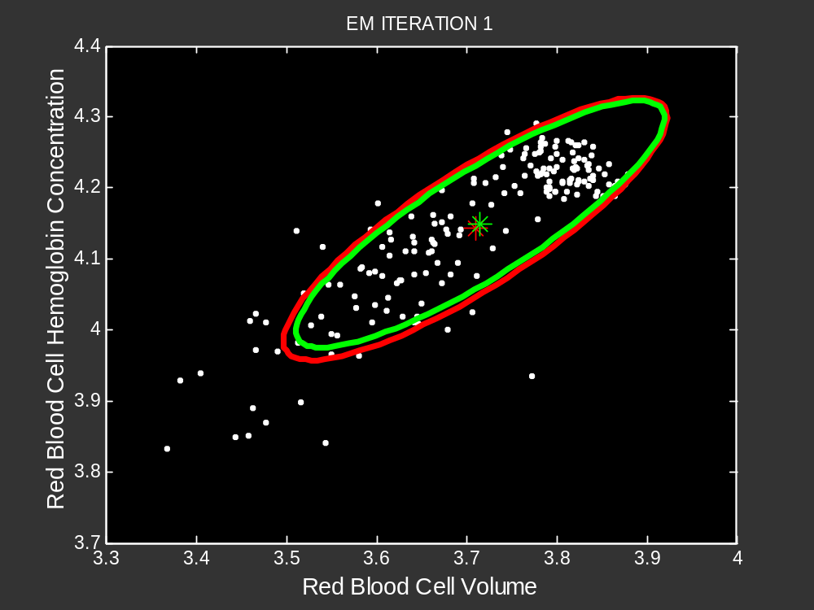
From P. Smyth
ICML 2001

Slide 23
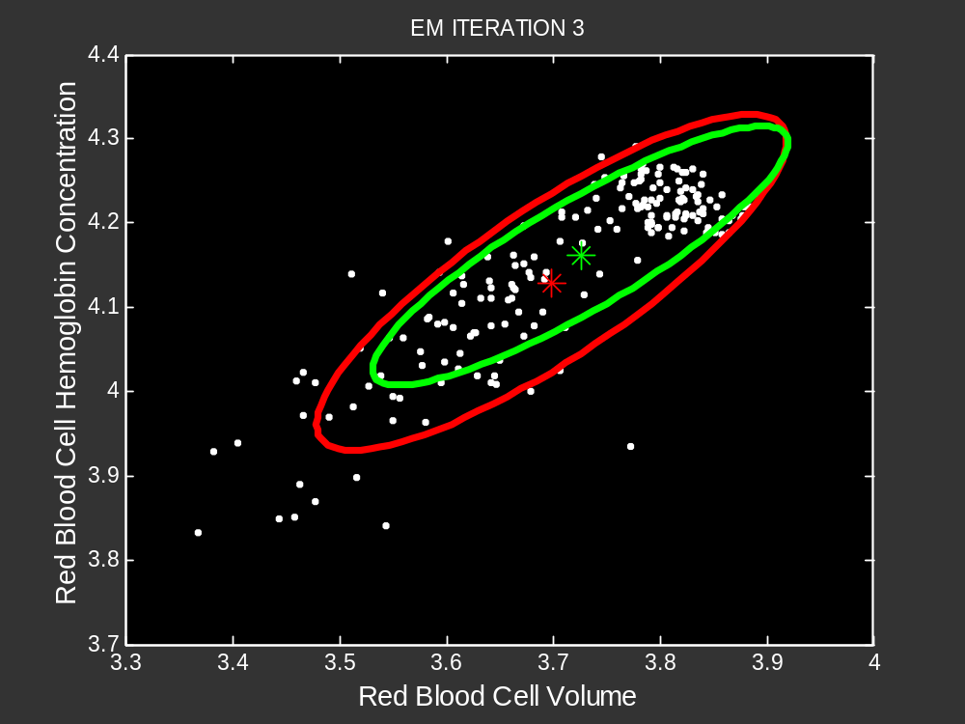
From P. Smyth
ICML 2001

Slide 24
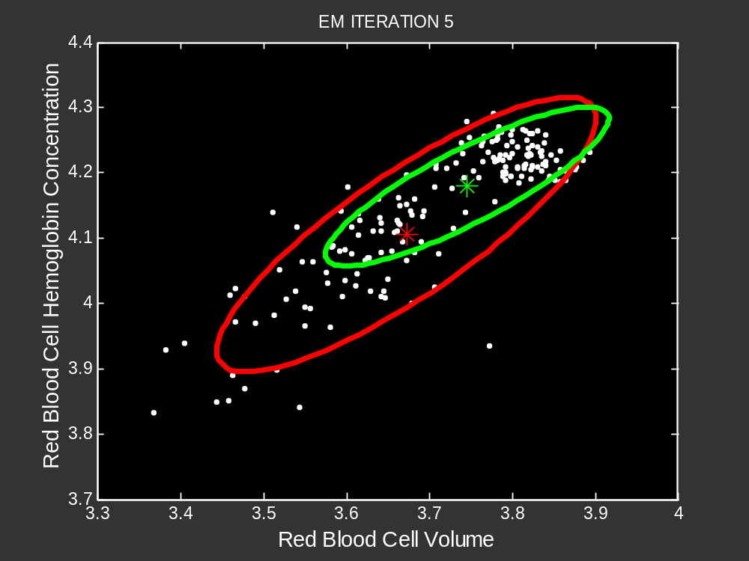
From P. Smyth
ICML 2001

Slide 25
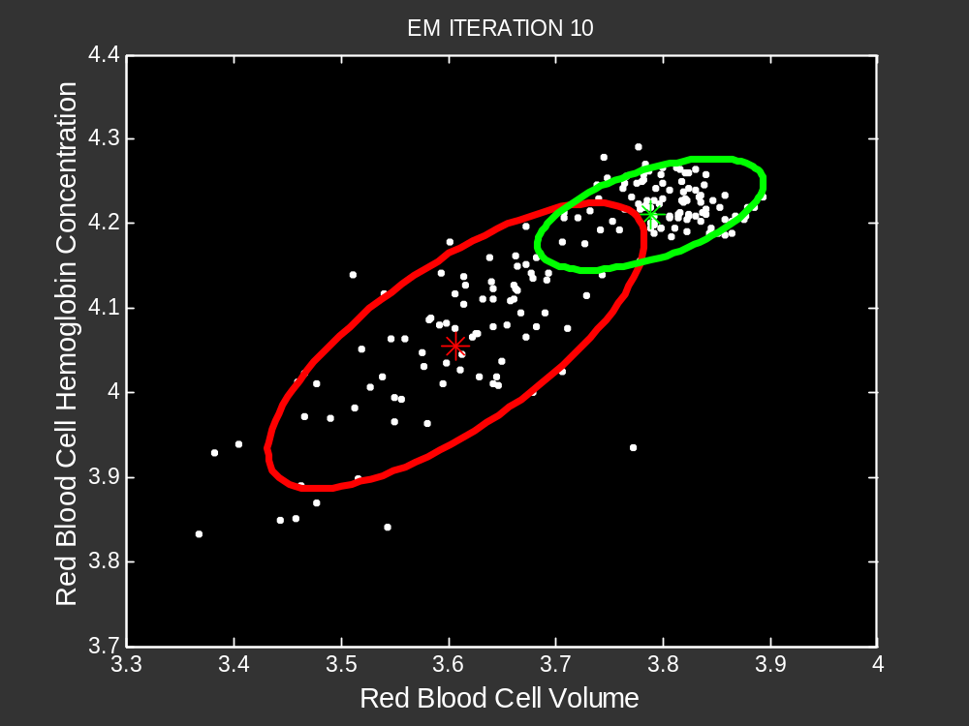
From P. Smyth
ICML 2001

Slide 26
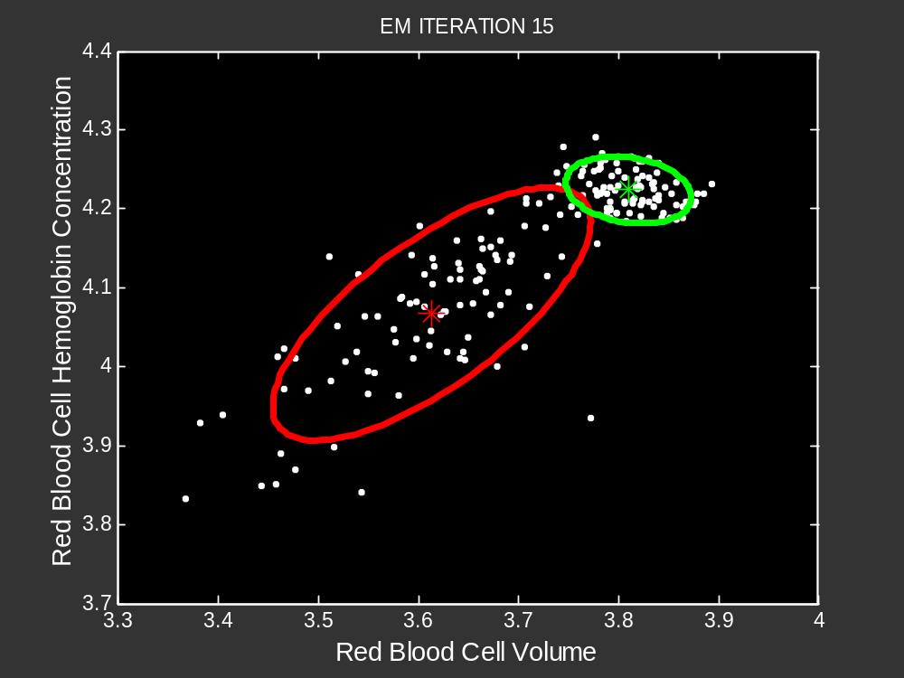
From P. Smyth
ICML 2001

Slide 27
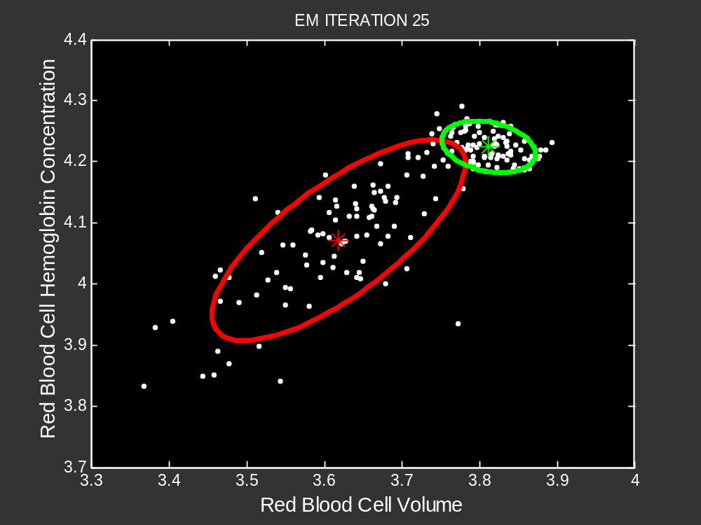
From P. Smyth
ICML 2001

Slide 28
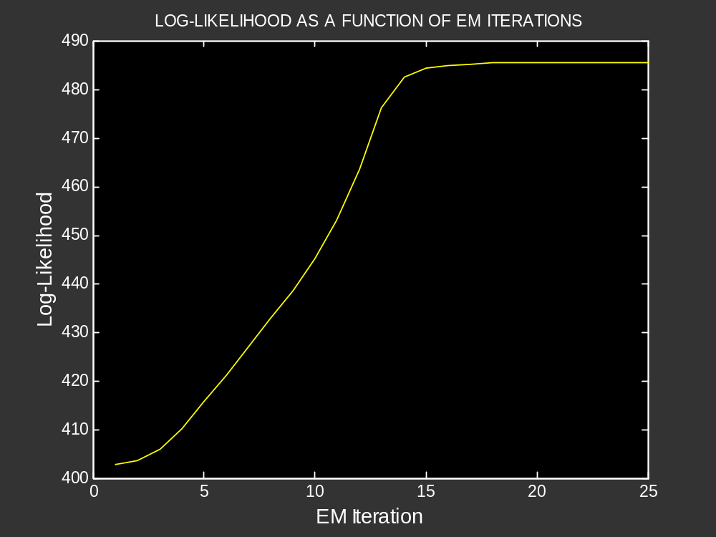
From P. Smyth
ICML 2001

Slide 29
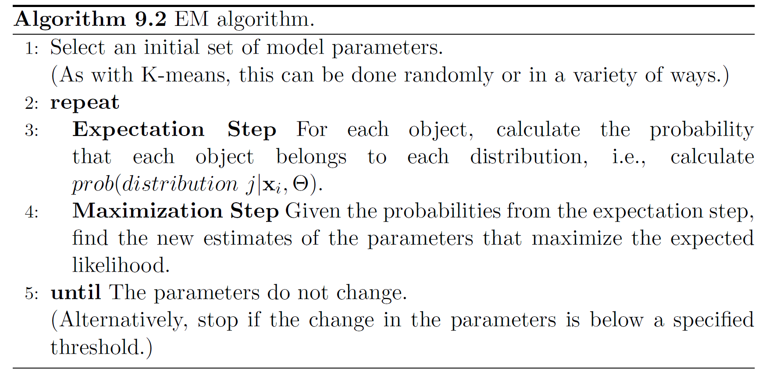
More Detailed EM Algorithm

Slide 30
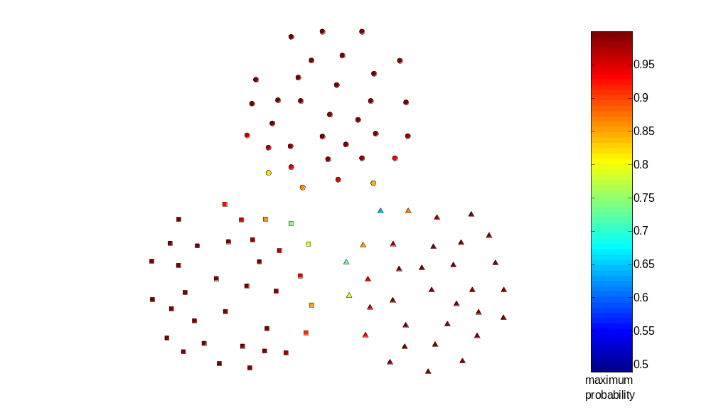
Probabilistic Clustering Applied to Sample Data

Slide 31
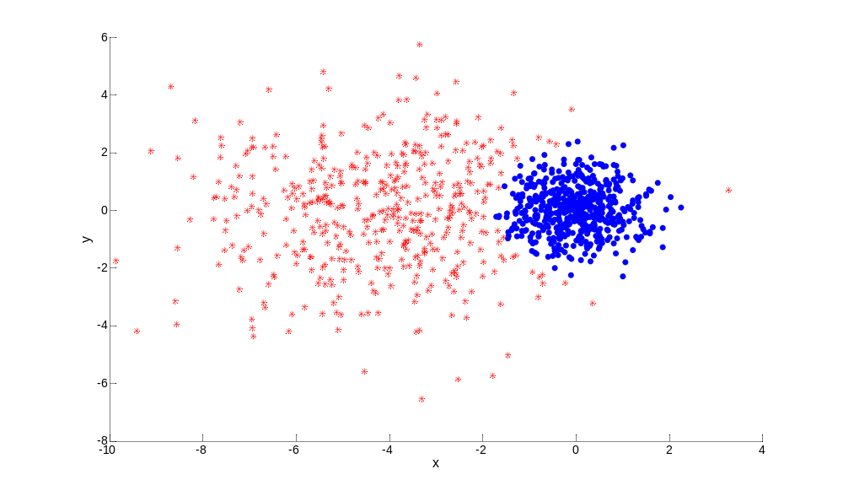
Probabilistic Clustering: Dense and Sparse Clusters
?

Slide 32
Problems with EM
Convergence can be slow
Only guarantees finding local maxima
Makes some significant statistical assumptions
Number of parameters for Gaussian distribution grows as O(d²), d the number of dimensions
  Parameters associated with covariance matrix
  K-means only estimates cluster means, which grow as O(d)

Slide 33
Alternatives to EM
Method of moments / Spectral methods
  ICML 2014 workshop bibliography
  https://sites.google.com/site/momentsicml2014/bibliography
Markov chain Monte Carlo (MCMC)
Other approaches

Slide 34
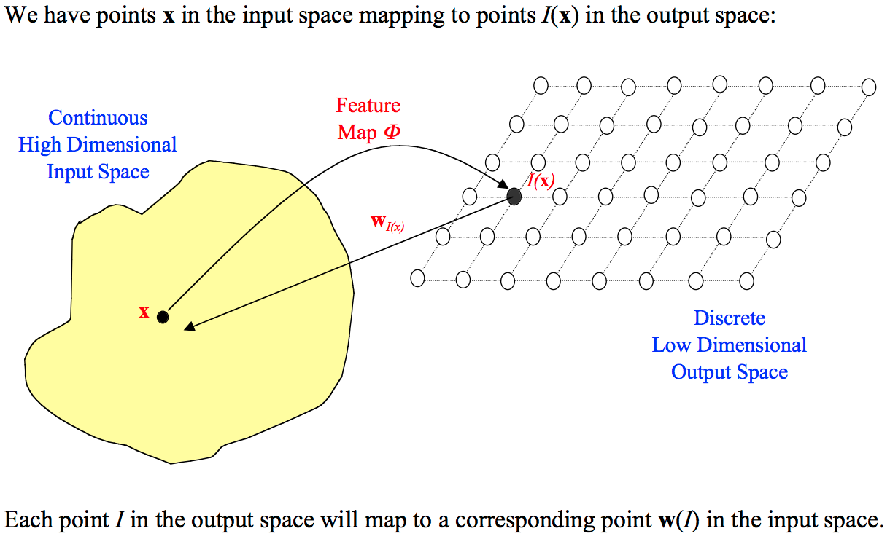
SOM: Self-Organizing Maps

Slide 35
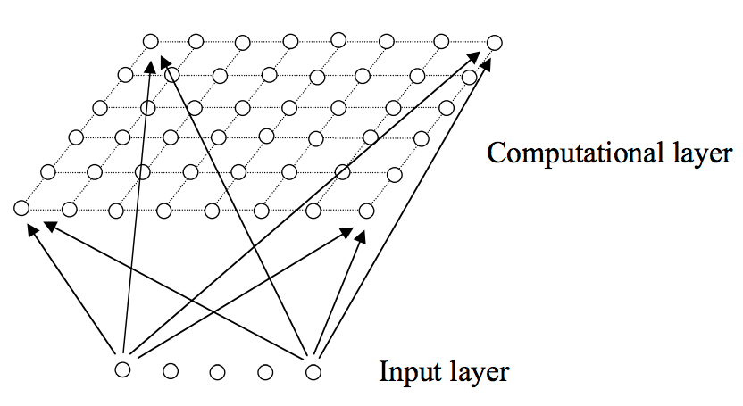
SOM: Self-Organizing Maps
A particular kind of SOM known as a Kohonen Network

Slide 36
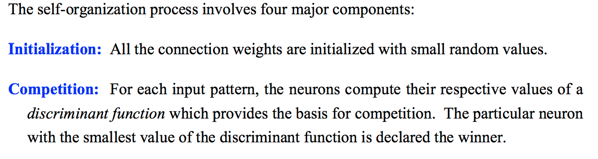
SOM: Four major components

Slide 37
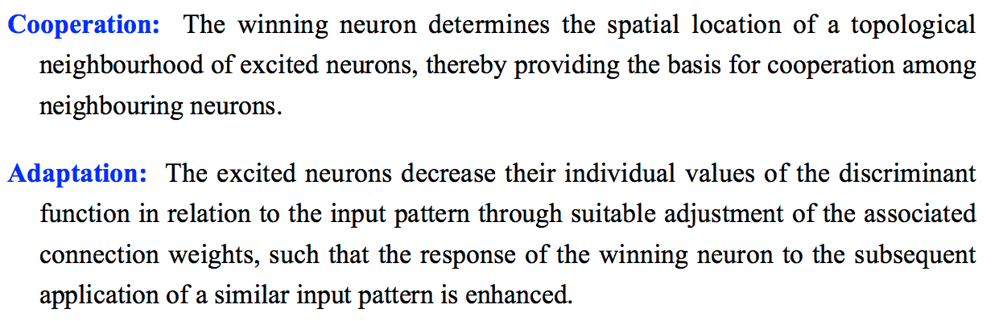
SOM: Four major components

Slide 38
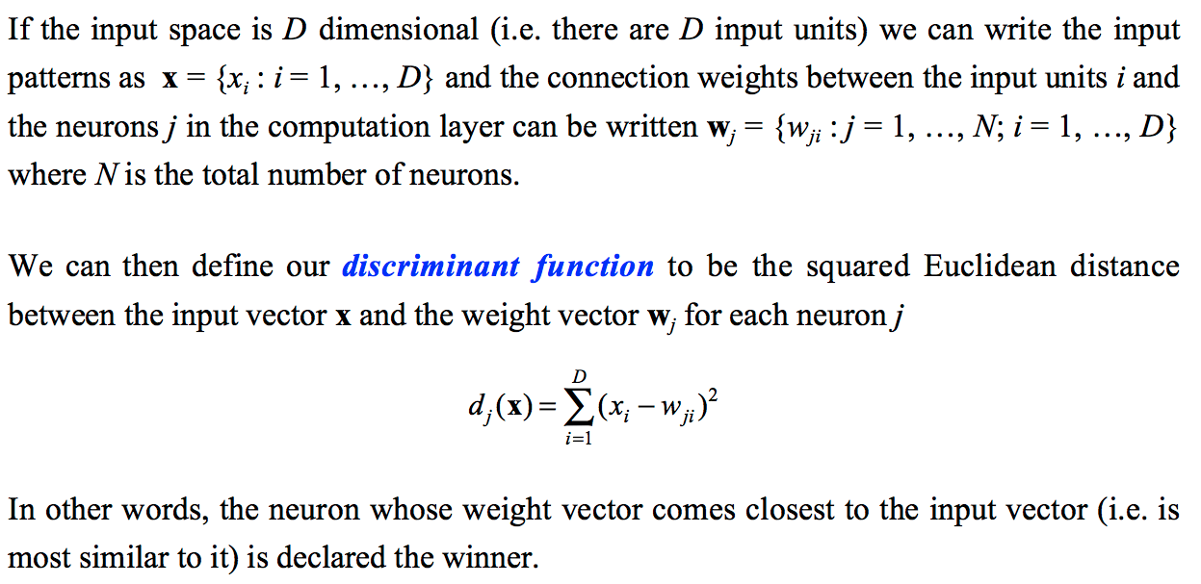
SOM: Four major components
The Competitive Process

Slide 39
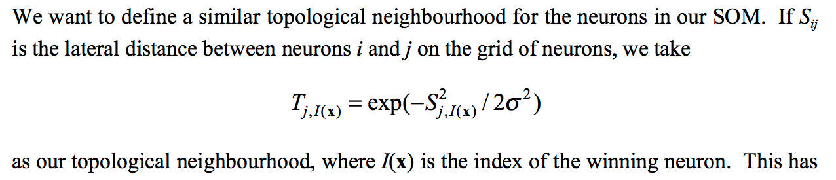

SOM: Four major components
The Cooperative Process

Slide 40
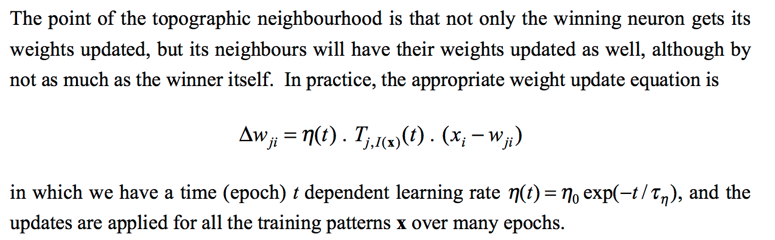
SOM: Four major components
The Adaptive Process

Slide 41
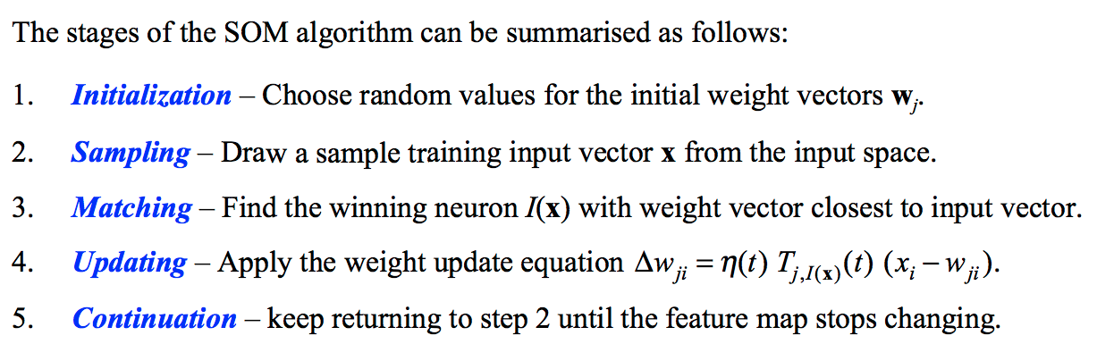
SOM: Four major components

Slide 42
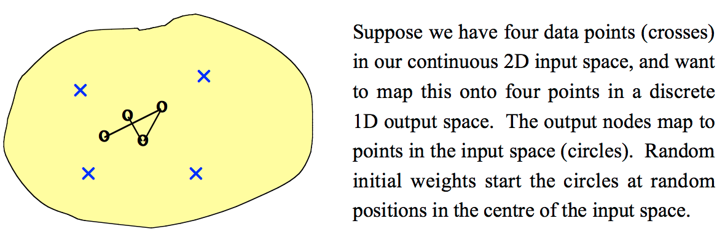
SOM: Visualizing

Slide 43
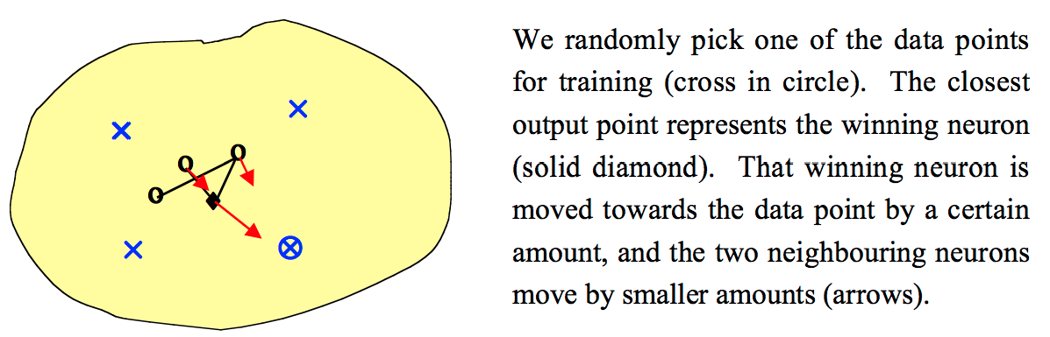
SOM: Visualizing

Slide 44
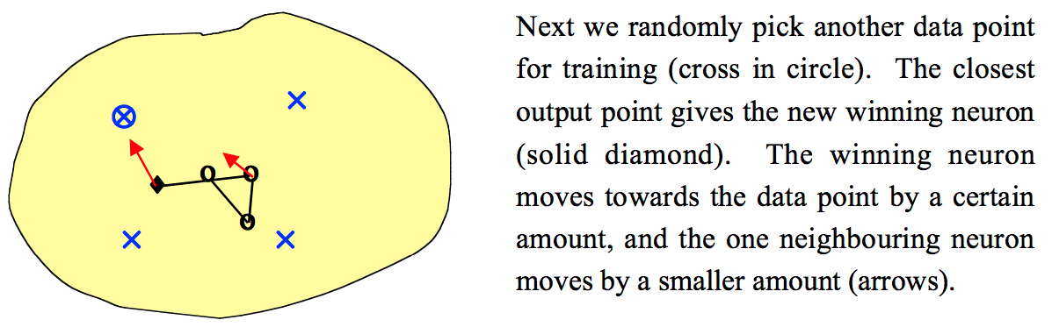
SOM: Visualizing

Slide 45

SOM: Visualizing

Slide 46

SOM: Self-Organizing Maps
Self-organizing maps (SOM)
  Centroid based clustering scheme
  Like K-means, a fixed number of clusters are specified
  However, the spatial relationship
  of clusters is also specified,
  typically as a grid
  Points are considered one by
  one
  Each point is assigned to the
  closest centroid
  Other centroids are updated based
  on their nearness to the closest centroid
  Kohonen, Teuvo, and Self-Organizing Maps. "Springer series in information sciences." Self-organizing maps 30 (1995).

Slide 47

SOM: Self-Organizing Maps
Updates are weighted by distance
  Centroids farther away are affected less
The impact of the updates decreases with each time
  At some point the centroids will not change much

Slide 48
SOM: Self-Organizing Maps
SOM can be viewed as a type of dimensionality reduction
If a two-dimensional grid is used, the results can be visualized

Slide 49

SOM Clusters of LA Times Document Data

Slide 50

Another SOM Example: 2D Points

Slide 51
Issues with SOM
Computational complexity
Locally optimal solution
Grid is somewhat arbitrary

Slide 52


Grid-based Clustering
A type of density-based clustering

Slide 53
Subspace Clustering
Until now, we found clusters by considering all of the attributes
Some clusters may involve only a subset of attributes, i.e., subspaces of the data
  Example:
    When k-means is used to find document clusters, the resulting clusters can typically be characterized by 10 or so terms

Slide 54

Example

Slide 55

Example

Slide 56

Example

Slide 57

Example

Slide 58
Clique Algorithm - Overview
A grid-based clustering algorithm that methodically finds subspace clusters
  Partitions the data space into rectangular units of equal volume
  Measures the density of each unit by the fraction of points it contains
  A unit is dense if the fraction of overall points it contains is above a user specified threshold, τ
  A cluster is a group of collections of contiguous (touching) dense units

Slide 59
Clique Algorithm
It is impractical to check each volume unit to see if it is dense since there is exponential number of such units
Monotone property of density-based clusters:
  If a set of points forms a density based cluster in k dimensions, then the same set of points is also part of a density based cluster in all possible subsets of those dimensions
Very similar to Apriori algorithm
Can find overlapping clusters

Slide 60

Clique Algorithm

Slide 61
Limitations of Clique
Time complexity is exponential in number of dimensions
  Especially if “too many” dense units are generated at lower stages
May fail if clusters are of widely differing densities, since the threshold is fixed
  Determining appropriate threshold and unit interval length can be challenging

Slide 62


Denclue (DENsity CLUstering)
Based on the notion of kernel-density estimation
  Contribution of each point to the density is given by an influence or kernel function
  Overall density is the sum of the contributions of all points
Formula and plot of Gaussian Kernel

Slide 63


Example of Density from Gaussian Kernel

Slide 64

DENCLUE Algorithm

Slide 65
DENCLUE Algorithm
Find the density function
Identify local maxima (density attractors)
Assign each point to the density attractor
  Follow direction of maximum increase in density
Define clusters as groups consisting of points associated with density attractor
Discard clusters whose density attractor has a density less than a user specified minimum, ξ
Combine clusters connected by paths of points that are connected by points with density above ξ

Slide 66
Graph-Based Clustering: General Concepts
Graph-Based clustering uses the proximity graph
  Start with the proximity matrix
  Consider each point as a node in a graph
  Each edge between two nodes has a weight which is the proximity between the two points
  Initially the proximity graph is fully connected
  MIN (single-link) and MAX (complete-link) can be viewed in graph terms
In the simplest case, clusters are connected components in the graph.

Slide 67
CURE Algorithm: Graph-Based Clustering
Agglomerative hierarchical clustering algorithms vary in terms of how the proximity of two clusters are computed
    MIN (single link)
      susceptible to noise/outliers
    MAX (complete link)/GROUP AVERAGE/Centroid/Ward’s:
      may not work well with non-globular clusters
CURE algorithm tries to handle both problems

Slide 68
CURE Algorithm
Represents a cluster using multiple representative points
  Representative points are found by selecting a constant number of points from a cluster
    First representative point is chosen to be the point furthest from the center of the cluster
    Remaining representative points are chosen so that they are farthest from all previously chosen points

Slide 69
CURE Algorithm
“Shrink” representative points toward the center of the cluster by a factor, α
Shrinking representative points toward the center helps avoid problems with noise and outliers
Cluster similarity is the similarity of the closest pair of representative points from different clusters
×
×

Slide 70
CURE Algorithm
Uses agglomerative hierarchical scheme to perform clustering;
  α = 0: similar to centroid-based
  α = 1: somewhat similar to single-link
CURE is better able to handle clusters of arbitrary shapes and sizes

Slide 71

Experimental Results: CURE
Picture from CURE, Guha, Rastogi, Shim.

Slide 72

Experimental Results: CURE
(centroid)
(single link)
Picture from CURE, Guha, Rastogi, Shim.

Slide 73


CURE Cannot Handle Differing Densities
Original Points
CURE

Slide 74
Graph-Based Clustering: Chameleon
Based on several key ideas
  Sparsification of the proximity graph
  Partitioning the data into clusters that are relatively pure subclusters of the “true” clusters
  Merging based on preserving characteristics of clusters

Slide 75
Graph-Based Clustering: Sparsification
The amount of data that needs to be processed is drastically reduced
  Sparsification can eliminate more than 99% of the entries in a proximity matrix
  The amount of time required to cluster the data is drastically reduced
  The size of the problems that can be handled is increased

Slide 76
Graph-Based Clustering: Sparsification …
Clustering may work better
  Sparsification techniques keep the connections to the most similar (nearest) neighbors of a point while breaking the connections to less similar points.
  The nearest neighbors of a point tend to belong to the same class as the point itself.
  This reduces the impact of noise and outliers and sharpens the distinction between clusters.
Sparsification facilitates the use of graph partitioning algorithms (or algorithms based on graph partitioning algorithms)
  Chameleon and Hypergraph-based Clustering

Slide 77

Sparsification in the Clustering Process

Slide 78
Limitations of Current Merging Schemes
Existing merging schemes in hierarchical clustering algorithms are static in nature
  MIN or CURE:
    Merge two clusters based on their closeness (or minimum distance)
  GROUP-AVERAGE:
    Merge two clusters based on their average connectivity

Slide 79


Limitations of Current Merging Schemes
(a)
(b)
(c)
(d)
Closeness schemes will merge (a) and (b)
Average connectivity schemes will merge (c) and (d)

Slide 80

Chameleon: Clustering Using Dynamic Modeling
Adapt to the characteristics of the data set to find the natural clusters
Use a dynamic model to measure the similarity between clusters
  Main properties are the relative closeness and relative inter-connectivity of the cluster
  Two clusters are combined if the resulting cluster shares certain properties with the constituent clusters
  The merging scheme preserves self-similarity

Slide 81
Relative Interconnectivity

Slide 82
Relative Closeness

Slide 83
Chameleon: Steps
Preprocessing Step:
Represent the data by a Graph
  Given a set of points, construct the k-nearest-neighbor (k-NN) graph to capture the relationship between a point and its k nearest neighbors
  Concept of neighborhood is captured dynamically (even if region is sparse)
Phase 1: Use a multilevel graph partitioning algorithm on the graph to find a large number of clusters of well-connected vertices
  Each cluster should contain mostly points from one “true” cluster, i.e., be a sub-cluster of a “real” cluster

Slide 84
Chameleon: Steps …
Phase 2: Use Hierarchical Agglomerative Clustering to merge sub-clusters
  Two clusters are combined if the resulting cluster shares certain properties with the constituent clusters
  Two key properties used to model cluster similarity:
    Relative Interconnectivity: Absolute interconnectivity of two clusters normalized by the internal connectivity of the clusters
    Relative Closeness: Absolute closeness of two clusters normalized by the internal closeness of the clusters

Slide 85

Experimental Results: CHAMELEON

Slide 86

Experimental Results: CURE (10 clusters)

Slide 87

Experimental Results: CURE (15 clusters)

Slide 88

Experimental Results: CHAMELEON

Slide 89

Experimental Results: CURE (9 clusters)

Slide 90

Experimental Results: CURE (15 clusters)

Slide 91

Experimental Results: CHAMELEON

Slide 92
Graph-Based Clustering: SNN Approach
Shared Nearest Neighbor (SNN) graph: the weight of an edge is the number of shared neighbors between vertices given that the vertices are connected
i
j
i
j
4

Slide 93


Creating the SNN Graph
Sparse Graph
Link weights are similarities between neighboring points
Shared Near Neighbor Graph
Link weights are number of Shared Nearest Neighbors

Slide 94
Jarvis-Patrick Clustering
First, the k-nearest neighbors of all points are found
  In graph terms this can be regarded as breaking all but the k strongest links from a point to other points in the proximity graph
A pair of points is put in the same cluster if
  any two points share more than T neighbors and
  the two points are in each others k nearest neighbor list
For instance, we might choose a nearest neighbor list of size 20 and put points in the same cluster if they share more than 10 near neighbors
Jarvis-Patrick clustering is too brittle

Slide 95

When Jarvis-Patrick Works Reasonably Well
Original Points
Jarvis Patrick Clustering
6 shared neighbors out of 20

Slide 96


When Jarvis-Patrick Does NOT Work Well
Smallest threshold, T, that does not merge clusters.
Threshold of T - 1

Slide 97
SNN Density-Based Clustering
Combines:
  Graph based clustering (similarity definition based on number of shared nearest neighbors)
  Density based clustering (DBSCAN-like approach)
SNN density measures whether a point is surrounded by similar points (with respect to its nearest neighbors)

Slide 98
SNN Clustering Algorithm
Compute the similarity matrix
This corresponds to a similarity graph with data points for nodes and edges whose weights are the similarities between data points
Sparsify the similarity matrix by keeping only the k most similar neighbors
This corresponds to only keeping the k strongest links of the similarity graph
Construct the shared nearest neighbor graph from the sparsified similarity matrix.
At this point, we could apply a similarity threshold and find the connected components to obtain the clusters (Jarvis-Patrick algorithm)
Find the SNN density of each Point.
Using a user specified parameters, Eps, find the number points that have an SNN similarity of Eps or greater to each point. This is the SNN density of the point

Slide 99
SNN Clustering Algorithm …
Find the core points
Using a user specified parameter, MinPts, find the core points, i.e., all points that have an SNN density greater than MinPts
Form clusters from the core points
If two core points are within a “radius”, Eps, of each other they are placed in the same cluster
Discard all noise points
All non-core points that are not within a “radius” of Eps of a core point are discarded
Assign all non-noise, non-core points to clusters
This can be done by assigning such points to the nearest core point
(Note that steps 4-8 are DBSCAN)

Slide 100




SNN Density
a) All Points b) High SNN Density
c) Medium SNN Density d) Low SNN Density

Slide 101

SNN Clustering Can Handle Differing Densities
Original Points
SNN Clustering

Slide 102


SNN Clustering Can Handle Other Difficult Situations

Slide 103


Finding Clusters of Time Series In Spatio-Temporal Data
SNN Clusters of SLP.
SNN Density of Points on the Globe.

Slide 104
Limitations of SNN Clustering
Does not cluster all the points
Complexity of SNN Clustering is high
  O( n * time to find numbers of neighbor within Eps)
  In worst case, this is O(n²)
  For lower dimensions, there are more efficient ways to find the nearest neighbors
    R* Tree
    k-d Trees
Parameteriziation is not easy

Slide 105
Characteristics of Data, Clusters, and
Clustering Algorithms
A cluster analysis is affected by characteristics of
  Data
  Clusters
  Clustering algorithms
Looking at these characteristics gives us a number of dimensions that you can use to describe clustering algorithms and the results that they produce
© Tan,Steinbach, Kumar Introduction to Data Mining 4/13/2006 105

Slide 106
Characteristics of Data
High dimensionality
Size of data set
Sparsity of attribute values
Noise and Outliers
Types of attributes and type of data sets
Differences in attribute scales
Properties of the data space
  Can you define a meaningful centroid

Slide 107
Characteristics of Clusters
Data distribution
Shape
Differing sizes
Differing densities
Poor separation
Relationship of clusters
Types of clusters
  Center-based, contiguity-based, density-based
Subspace clusters

Slide 108
Characteristics of Clustering Algorithms
Order dependence
Non-determinism
Parameter selection
Scalability
Underlying model
Optimization based approach

Slide 109
Comparison of MIN and EM-Clustering
We assume EM clustering using the Gaussian (normal) distribution.
MIN is hierarchical, EM clustering is partitional.
Both MIN and EM clustering are complete.
MIN has a graph-based (contiguity-based) notion of a cluster, while EM clustering has a prototype (or model-based) notion of a cluster.
MIN will not be able to distinguish poorly separated clusters, but EM can manage this in many situations.
MIN can find clusters of different shapes and sizes; EM clustering prefers globular clusters and can have trouble with clusters of different sizes.
Min has trouble with clusters of different densities, while EM can often handle this.
Neither MIN nor EM clustering finds subspace clusters.

Slide 110
Comparison of MIN and EM-Clustering
MIN can handle outliers, but noise can join clusters; EM clustering can tolerate noise, but can be strongly affected by outliers.
EM can only be applied to data for which a centroid is meaningful; MIN only requires a meaningful definition of proximity.
EM will have trouble as dimensionality increases and the number of its parameters (the number of entries in the covariance matrix) increases as the square of the number of dimensions; MIN can work well with a suitable definition of proximity.
EM is designed for Euclidean data, although versions of EM clustering have been developed for other types of data. MIN is shielded from the data type by the fact that it uses a similarity matrix.
MIN makes no distribution assumptions; the version of EM we are considering assumes Gaussian distributions.

Slide 111
Comparison of MIN and EM-Clustering
EM has an O(n) time complexity; MIN is O(n²log(n)).
Because of random initialization, the clusters found by EM can vary from one run to another; MIN produces the same clusters unless there are ties in the similarity matrix.
Neither MIN nor EM automatically determine the number of clusters.
MIN does not have any user-specified parameters; EM has the number of clusters and possibly the weights of the clusters.
EM clustering can be viewed as an optimization problem; MIN uses a graph model of the data.
Neither EM or MIN are order dependent.

Slide 112
Comparison of DBSCAN and K-means
Both are partitional.
K-means is complete; DBSCAN is not.
K-means has a prototype-based notion of a cluster; DB uses a density-based notion.
K-means can find clusters that are not well-separated. DBSCAN will merge clusters that touch.
DBSCAN handles clusters of different shapes and sizes; K-means prefers globular clusters.

Slide 113
Comparison of DBSCAN and K-means
DBSCAN can handle noise and outliers; K-means performs poorly in the presence of outliers
K-means can only be applied to data for which a centroid is meaningful; DBSCAN requires a meaningful definition of density
DBSCAN works poorly on high-dimensional data; K-means works well for some types of high-dimensional data
Both techniques were designed for Euclidean data, but extended to other types of data
DBSCAN makes no distribution assumptions; K-means is really assuming spherical Gaussian distributions

Slide 114
Comparison of DBSCAN and K-means
K-means has an O(n) time complexity; DBSCAN is O(n^2)
Because of random initialization, the clusters found by K-means can vary from one run to another; DBSCAN always produces the same clusters
DBSCAN automatically determines the number of clusters; K-means does not
K-means has only one parameter, DBSCAN has two.
K-means clustering can be viewed as an optimization problem and as a special case of EM clustering; DBSCAN is not based on a formal model.

